Slide 1
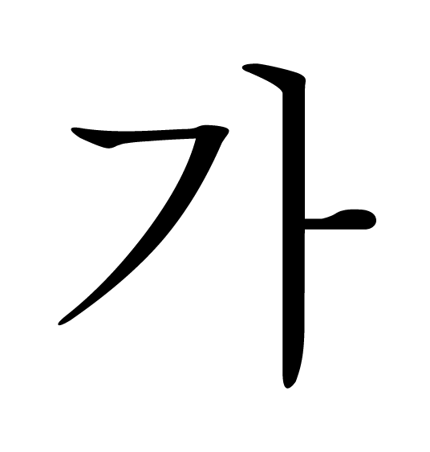
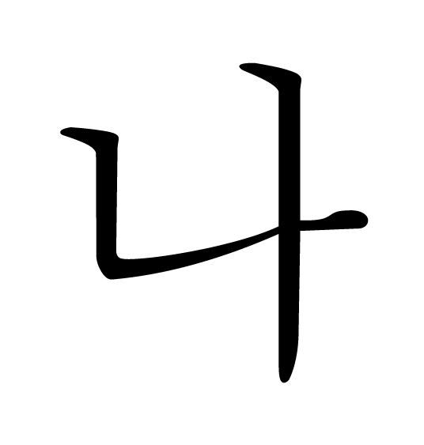
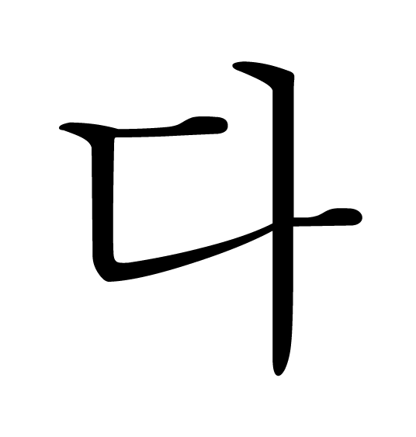

Slide 2
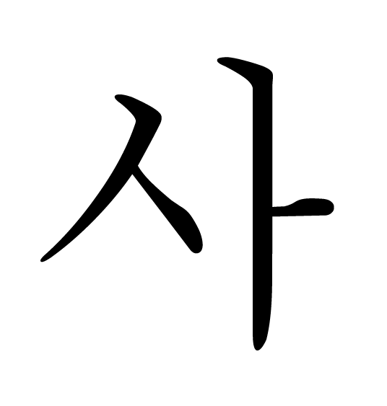
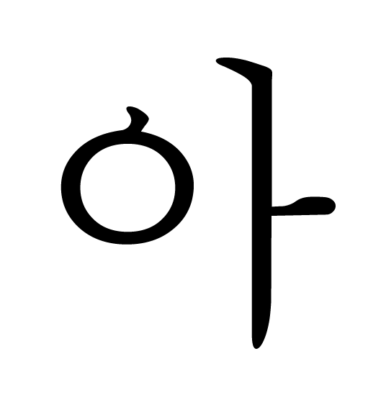

Slide 3
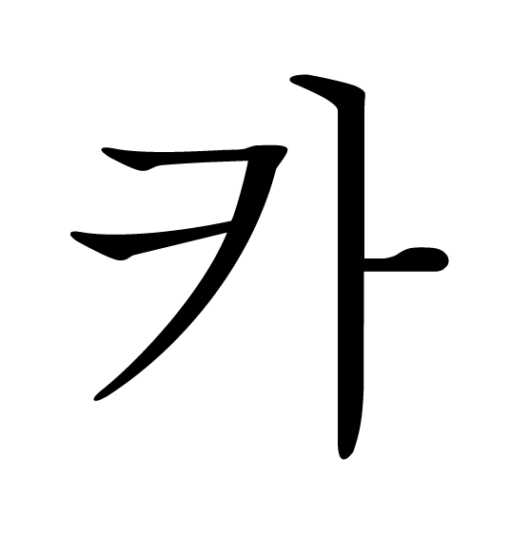
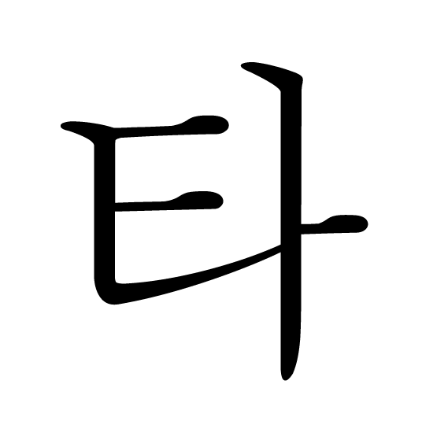

Slide 4
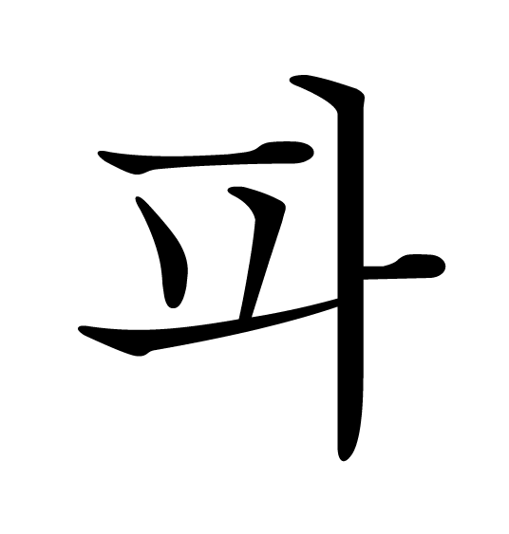

Slide 5
ㄱ
ㄴ
ㄷ
ㄹ

Slide 6
ㅁ
ㅂ
ㅅ
ㅇ

Slide 7
ㅈ
ㅊ
ㅋ
ㅌ

Slide 8
ㅍ
ㅎ

Slide 9
ㅏ
ㅑ
ㅓ
ㅕ

Slide 10
ㅗ
ㅛ
ㅜ
ㅠ

Slide 11
ㅡ
ㅣ

